Slide 1
Fake Tweet Detection

Slide 2
Objective
Categorise a tweet as Fake or Real
Add authors of fake tweets to spam list
Run program via Flask REST API

Slide 3
Details
Dataset : Kaggle fake news detection dataset
Model : Logistic Regression
API : Twitter API v2 (Tweepy v4.0.0)
Platform: Google Colab, PyCharm

Slide 4
Procedure
Upload train data
Cleaning the data
Removing unwanted column
Removing Stopwords
Stemming
Removing emojis
CountVectorizer
TdfIdfTransform
GridSearchCV

Slide 5
Procedure
Train a Logistic Regression model
Get recent tweets from twitter using Tweepy
Convert the json response to a csv file
Predict on the contents of the csv file
For fake tweets, find the original author of the tweet
Add user id of the author to Spam file
Call program via Flask REST API

Slide 6
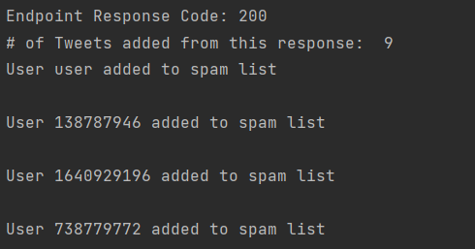
Sample Output

Slide 7
Utility to the user
Identify users/bots propagating fake news
Report/Block them to reduce the spread of misinformation
Cleaner Twitter feed

